Slide 2
3PO BASIC
Part 2

Slide 3
3PO MECHANICS
There is one game, three referees, but still only one officiating team.

Slide 4
modules
R3.3 Court Coverage – Front Court
R3.4 Rotation
R3.5 Lead Position & Transition
R3.6. Trail Position & Transition
R3.7. Centre Position & Transition
R3.8 Fastbreak

Slide 5
TERMINOLOGY 1
IOT | Individual Officiating Techniques
Obvious play (OP) | Play that has to be covered correct in all cases (no excuses)
Primary coverage (PC) | Area of responsibility and actions that referee has to be able to cover always
Dual Coverage (DC) | Area of responsibility and actions that two referees have overlapping primaries on same area or play.
Secondary coverage (SC) | Area of responsibility and actions that referee is able to cover after ensuring that primary coverage is covered
Extended coverage (EC) | At the highest level of officiating, an official has to be able to extend coverage on two different play situations at the same time
HSB / page 187-188

Slide 6
TERMINOLOGY 2
Giving help (GH) | Referee who offers assistance outside his/her primary and makes correct call after allowing partner to make the call in his/her primary
Regular call (RC) | Considered to be normal call by designated referee (no assistance)
Referee the defence (RD) | The priority when refereeing on ball is to focus the attention on the legality of the defensive player while keeping the offensive player with the ball in your field of vision
Open angle (OA) | Clear view of the action in a referee’s primary / secondary coverage area. Never leave an open look.
Closed angle (CA) | A stacked or straight-lined view of the action area in a referee’s primary / secondary coverage area.
Cross Step (CS) | When play starts to progress in one direction and designated referee takes steps to opposite direction.
HSB / page 187-188

Slide 7
TERMINOLOGY 3
RSBQ | Definition for Rhythm, Speed, Balance & Quickness.
Working area (WA) | Area where referee normally operates most of his time in that position.
Action area (AA) | Action area may involve players with or without ball. Knowledge on various play situations (pick & roll, post-ups, rebounding) will help referees identify action areas in their primary.
EOP | End of the Period
EOG | End of the Game
Ball-side | This refers to the position of the ball. When the playing court is divided by an imaginary line extending from basket to basket, the side of the playing court on which the ball is located is called the "ball-side".
HSB / page 187-188

Slide 8
TERMINOLOGY 4
Opposite side | This refers to the side of the playing court which is furthest away from the scorer's table
Strong side (SS) | Side of the court where are Lead & Trail
Weak side (WS) | Side of the court where is Center
Close down (CD) | The position of the Lead where he should move before actual rotation starts.
Switch (SW) | This refers to a dead ball situation when the calling of a foul necessitates a switch in position by the officials. The official who calls the foul always moves to the opposite side after reporting the foul to the scorer’s table. Whenever there is a throw-in situation, two officials are always on the ball-side.
1-2-3 Play | Play situation where L-T-C covers part of the play.
HSB / page 187-188

Slide 9
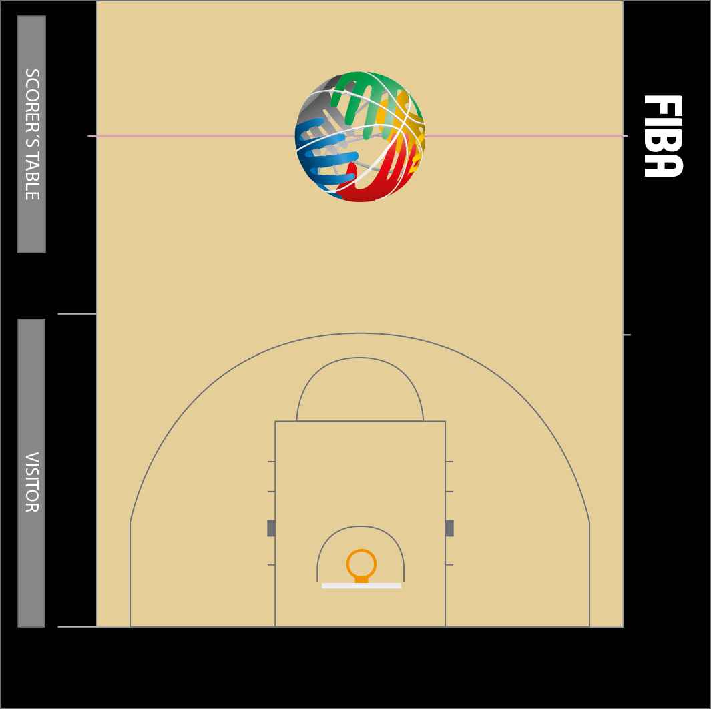
3PO / PRINCIPLE COVERAGE
Strong side - left
HSB / page 192
Notes:
FIBA
ME-11_L_time_distance_
stationary_referee defence
ME-15_Afrobasket_L+C_ distance and until end of action
ME-21_new L too slow in transition

Slide 10
3PO / PRINCIPLE COVErage
Strong side - right
HSB / page 192
Notes:
FIBA
ME-11_L_time_distance_
stationary_referee defence
ME-15_Afrobasket_L+C_ distance and until end of action
ME-21_new L too slow in transition

Slide 11
3PO / FUNCTIONAL COVERAGE
Strong side - right
HSB / page 193
Notes:
FIBA
ME-11_L_time_distance_
stationary_referee defence
ME-15_Afrobasket_L+C_ distance and until end of action
ME-21_new L too slow in transition

Slide 12
3PO / PRINCIPLE COVErage
Strong side - right
HSB / page 193
Notes:
FIBA
ME-11_L_time_distance_
stationary_referee defence
ME-15_Afrobasket_L+C_ distance and until end of action
ME-21_new L too slow in transition

Slide 13
BASIC ROTATION / animation
HSB / page 193-198
Phases of Rotation
Be in time on baseline (T-L)
Close Down
(ball in the middle)
Rotation early
Walk & Referee
Scan the Paint & Play
T rotates with L
T picks-up the new play on his side (high post).
C keeps refereeing until L finished rotation.
No rotation with quick shot/penetration on the weak side
1.
Action area
Close down
Rotation
Notes:
FIBA
ME-11_L_time_distance_
stationary_referee defence
ME-15_Afrobasket_L+C_ distance and until end of action
ME-21_new L too slow in transition

Slide 14
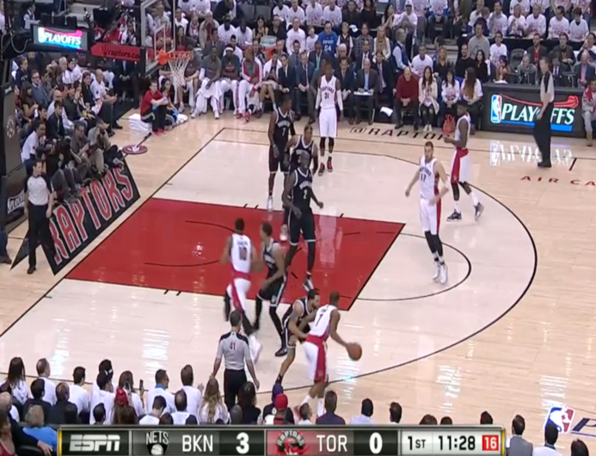
ROTATION / L EAD & CENTER
HSB / page 198
L dictates the rotation according to position of the ball
Rotate early / often.
Be quick but don’t hurry.
No need to rush (sharp walking) and keep refereeing during entire rotation.
Scan the paint or next play as rotating.
When L starts rotation,
C needs to stay in his position to cover the play
until L has arrived to new position on ball side and is ready to referee the play (45°)
Notes:
ME-10 _L_good rotation
RO-01_L_rotation too late_C_stays with play correctly
ME-12 _L_rotation_wide45_referee def
ME-22_L_incorrect rotations x 3
ME-01_C_extended coverage in low post
RO-02_L_rotation too late_C_moves up and down_behind play
ME-17_new T stays with play in rotation

Slide 15
ROTATION / LEAD & CENTER
HSB / page 198
Notes:
FIBA
ME-11_L_time_distance_
stationary_referee defence
ME-15_Afrobasket_L+C_ distance and until end of action
ME-21_new L too slow in transition

Slide 16
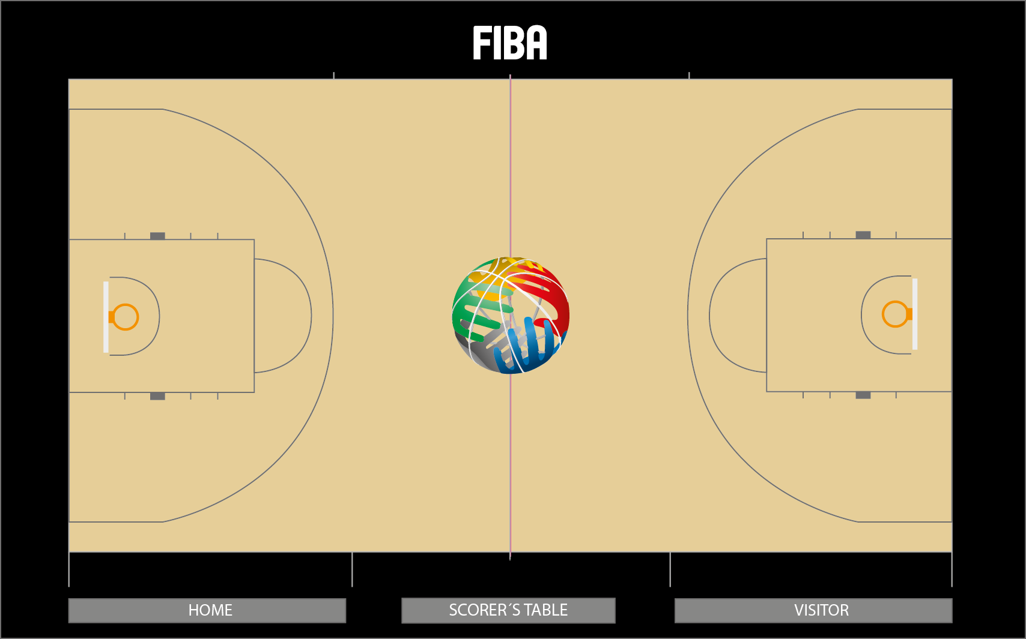
Transition / “missed rotation”
Adjustment – option 1 ( L & C )
HSB / page 199

Slide 17
Transition / “missed rotation”
Adjustment – option 2 ( T )
HSB / page 199

Slide 18
LEAD / TRANSITION
HSB / page 200
In transition from T to L
Turn quickly and start sprinting with power step.
Run as fast as possible in straight line to set-up position (middle of restricted area & three points line)
Facing the court all the time
More time you have on the baseline, more time you have to identify the progress of the play (link with Rotation).
Don’t curve or run under the basket or closer to the play – keep same distance (outside-outside angle).
Notes:
FIBA
ME-11_L_time_distance_
stationary_referee defence
ME-15_Afrobasket_L+C_ distance and until end of action
ME-21_new L too slow in transition

Slide 19
trANSITION TRAIL -> LEAD
ANIMATION
HSB / page 200
Correct
4 seconds
Stay outside of the play,
same distance/angle from the play
Outside
same distance same wide angle,
same speed & size
Outside
Notes:
FIBA
ME-11_L_time_distance_
stationary_referee defence
ME-15_Afrobasket_L+C_ distance and until end of action
ME-21_new L too slow in transition

Slide 20
trANSITION TRAIL -> LEAD
ANIMATION
HSB / page 200
Stay outside of the play,
same distance/angle from the play
Incorrect
Inside
shorter distance narrow angle,
looks faster-bigger
Outside
Notes:
FIBA
ME-11_L_time_distance_
stationary_referee defence
ME-15_Afrobasket_L+C_ distance and until end of action
ME-21_new L too slow in transition

Slide 21
LEAD / TRANSITION – 3PO ADVANCED
HSB / page 200
In transition from T to L
Ball is advancing on weak side to the front court
L can sprint directly to “Close Down” position to anticipate rotation.
Notes:
FIBA
ME-11_L_time_distance_
stationary_referee defence
ME-15_Afrobasket_L+C_ distance and until end of action
ME-21_new L too slow in transition

Slide 22
INDIVIDUAL / LEAD
HSB / page 201
Working on the baseline
Lead works outside the court
Keep torso toward front of rim (45°)
Adjust position with ball to maintain open (wide, outside-in) angle
Field of vision should enable you to see horizontally and vertically as clearly as possible (keep distance from play)
Find the initial position where you are able to cover the next play situation (anticipate the next play)
Control of the Game & Shot Clock
“Close Down” position is for rotation.
Close Down position
x
x
Generally NON working area
Notes:
ME-13_L_wide angle 45_referee defence
ML-02_L_cross call_C’s play
ME-14_L_wide45_ref def_T adjustment in the end
ML-01_L_cross call_C’s play

Slide 23
LEAD – OPEN ANGLE & 45°
HSB / page 201
Notes:
ME-13_L_wide angle 45_referee defence
ML-02_L_cross call_C’s play
ME-14_L_wide45_ref def_T adjustment in the end
ML-01_L_cross call_C’s play

Slide 24
LEAD – OPEN ANGLE & 45°
HSB / page 201
Notes:
ME-13_L_wide angle 45_referee defence
ML-02_L_cross call_C’s play
ME-14_L_wide45_ref def_T adjustment in the end
ML-01_L_cross call_C’s play

Slide 25
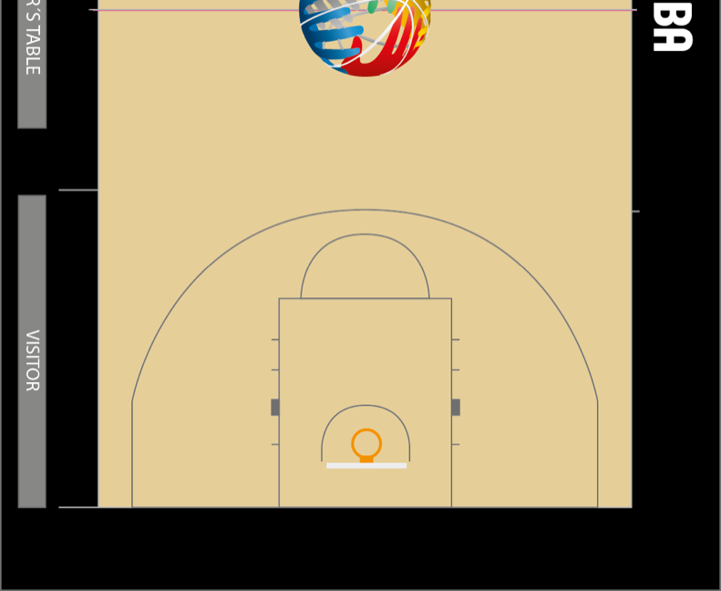
lead– cross call SLIDE
HSB / page 205-206
Analyses prove that called made by Lead on weakside drives are 70% incorrect.
Lead has to trust that Centre will cover the play
Incorrect

Slide 26
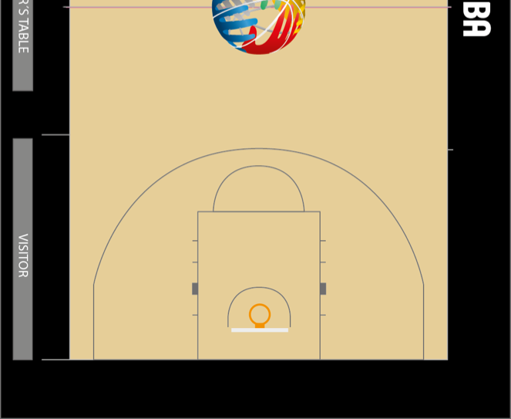
LEAD – CROSS STEP, OPEN ANGLE & 45°
SLIDE
HSB / page 202
Open Angle / Cross Step
Play in low post
Find the initial position where you are able to cover the next play situation (anticipate the next play)
Players move to the basket - step wide (Cross Step).
Notes:
ME-13_L_wide angle 45_referee defence
ML-02_L_cross call_C’s play
ME-14_L_wide45_ref def_T adjustment in the end
ML-01_L_cross call_C’s play

Slide 27
LEAD – CROSS STEP, OPEN ANGLE & 45°
animation
HSB / page 202
Cross Step
Notes:
ME-13_L_wide angle 45_referee defence
ML-02_L_cross call_C’s play
ME-14_L_wide45_ref def_T adjustment in the end
ML-01_L_cross call_C’s play

Slide 28
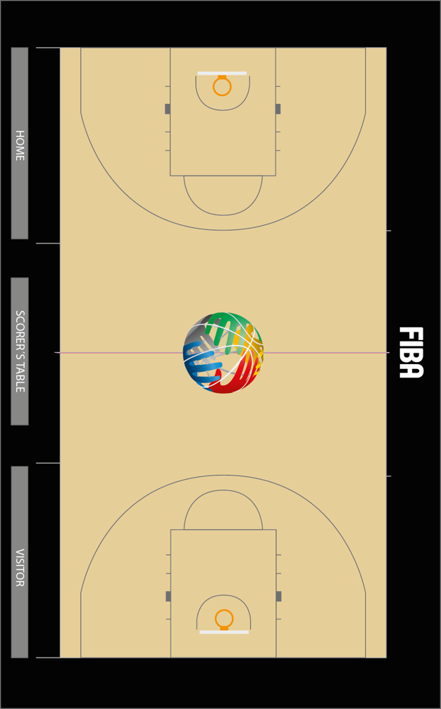
INDIVIDUAL / TRAIL
HSB / page 203
In transition from L to T
Stay behind the baseline (back court) until the ball has been passed from throw-in
Trail the play all the time, 2-3 steps (no overrunning)
Find the initial position where you are able to cover the ball and see possible next play in progress (45°).
Keep distance from the play
2/3 point shots (read the play)
Control of the game & shot clock
Notes:
FIBA
ME-20_T_trailing the play

Slide 29
3PO basic:
trail – individual transition
HSB / page 203

Slide 30
3PO basic:
trail – individual transition
HSB / page 203

Slide 31
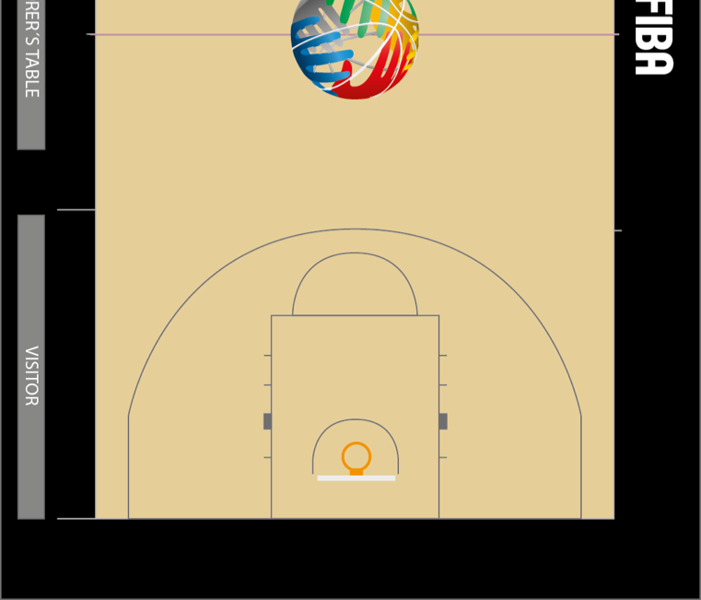
INDIVIDUAL / TRAIL
HSB / page 204
Half-court coverage
Find the initial position where you are able to see the defensive player when refereeing on ball
When the ball is near the sideline, move onto the court to maintain open look
Find the initial position where you are able to see as many players as possible when refereeing off ball
Keep distance from the play
Adjust your position according the play, read the play and react in time (one step ahead of the play)
Notes:
FIBA
ME-18_Afrobasket_T_adjustments x 2_incorrect/correct
ME-19_T_secondary_waiting L to make call_GOOD EXAMPLE

Slide 32
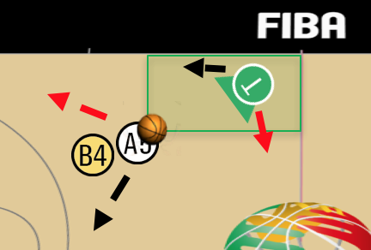
Trail / cross step
HSB / page 204

Slide 33
INDIVIDUAL / CENTER
HSB / page 205
In transition from C to C
Facing the court all the time.
Be ready to referee any play on weak side (help the T to have full coverage in transition)
Control the game & shot clock (8” violation)
C must adjust position at free throw line extended to create “open looks” based on the position of the players in the half court set
Run, stop & referee the play

Slide 34
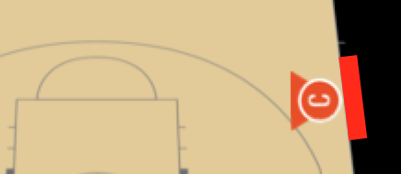
INDIVIDUAL / CENTER
HSB / page 205
Half court coverage
Working area:
set-up point Free Throw line extended
Top of the free throw circle / bottom of the imaginary free throw circle.
Find initial position where you are able to see the defensive player when refereeing on ball
Find the initial position where you are able to see as many players as possible when officiating off ball
Keep distance from the play
Stay inside the court
WORKING
AREA
SET UP POINT
Notes:
ME-02_C_inital position_next movement and play
MC-01_L_too narrow angle_C should wait and see if L makes a call.
ME-04_C_primary coverage
ME-06_C_primary_should step onto court
ME-08_C_cross step_too late-fast_moving when action_misses foul

Slide 35
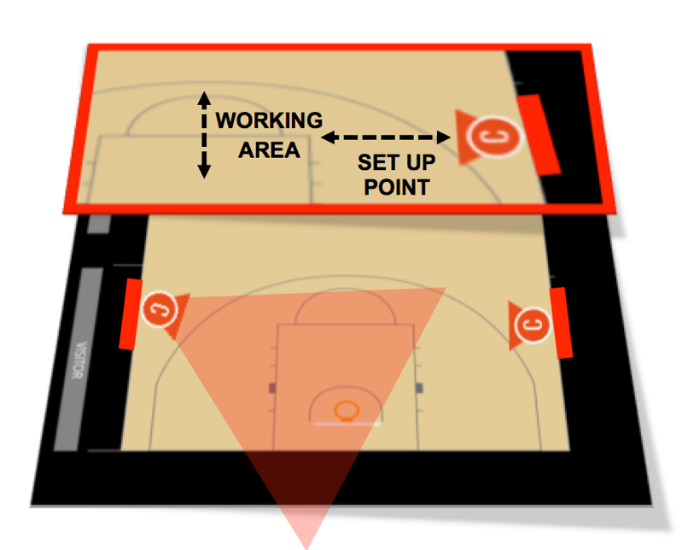
INDIVIDUAL / CENTER
HSB / page 205
Half court coverage
Adjust your position according to the play - read the play and react in time (one step ahead of the play)
Be ready to referee on ball when ball is in C primary (weakside).
Play starts in the C’s primary or goes to the basket from C’s side
Weak side drive
Strong-Weak side drive
C stays engaged with the play until the end of action (eg. Block / Charge on weak side – not L’s primary call across paint).
Notes:
ME-02_C_inital position_next movement and play
MC-01_L_too narrow angle_C should wait and see if L makes a call.
ME-04_C_primary coverage
ME-06_C_primary_should step onto court
ME-08_C_cross step_too late-fast_moving when action_misses foul

Slide 36
center – primary
HSB / page 204-205
Weak side is always C’s primary
Notes:
ME-02_C_inital position_next movement and play
MC-01_L_too narrow angle_C should wait and see if L makes a call.
ME-04_C_primary coverage
ME-06_C_primary_should step onto court
ME-08_C_cross step_too late-fast_moving when action_misses foul

Slide 37
CENTER – CROSS STEP, OPEN ANGLE & 45°
SLIDE
HSB / page 205-206
Cross Step
Find initial position where you are able to see the defensive player when refereeing on ball
Find the initial position where you are able to cover the ball and see possible next play in progress
Players start to move towards the basket
Center should step in opposite direction (Cross Step) of the players in order to maintain the open look (angle) on the play.

Slide 38
Trap weakside (active)
Centre’s coverage 1
HSB / page 206

Slide 39
Trap weakside
Centre’s coverage 2
HSB / page 206

Slide 40
3PO basic: Strongside transition

Slide 41
3PO basic: weakside transition

Slide 42
BASIC COVERAGE
Drive to THE BASKET / STRONG SIDE
Lead keeps outside-outside angle when drive on strong side.
Lead has the best angle to referee defense high & low.
Trail will follow the drive and make a cross step.

Slide 43
BASIC COVERAGE
Drive to THE KEY / STRONG SIDE
Lead keeps outside-outside angle when drive through the key (strong side)
Can adjust one step towards basket but normally not in the key area.
Center has to be ready to referee if there is a contact from his side.

Slide 44
BASIC COVERAGE
Drive to THE KEY / WEAK SIDE
HSB / page 205-206
If drives comes through the key from weak side, Center has the primary.
He needs to adjust position (before drive – read the play) one-two steps to the court.
Normally this play is not for the Lead (no cross call), only if contact is low (hacking) and from Lead side.

Slide 45
3PO basic:
Fast break– poSItions & COVERAGE
HSB / page 207
C has to run fast in every fast break.
Important: Both L & C are able to have stationary position to referee when the play starts, it is normally a dual coverage.

