Slide 2
3PO BASIC
Part 1

Slide 3
3PO MECHANICS
There is one game, three referees, but still only one officiating team.

Slide 4
modules
R3.0 Introduction
R3.1 Court Positions
R3.2 Jump Ball & Start of Period

Slide 5
TERMINOLOGY 1
IOT | Individual Officiating Techniques
Obvious play (OP) | Play that has to be covered correct in all cases (no excuses)
Primary coverage (PC) | Area of responsibility and actions that referee has to be able to cover always
Dual Coverage (DC) | Area of responsibility and actions that two referees have overlapping primaries on same area or play.
Secondary coverage (SC) | Area of responsibility and actions that referee is able to cover after ensuring that primary coverage is covered
Extended coverage (EC) | At the highest level of officiating, an official has to be able to extend coverage on two different play situations at the same time
HSB / page 187-188

Slide 6
TERMINOLOGY 2
Giving help (GH) | Referee who offers assistance outside his/her primary and makes correct call after allowing partner to make the call in his/her primary
Regular call (RC) | Considered to be normal call by designated referee (no assistance)
Referee the defence (RD) | The priority when refereeing on ball is to focus the attention on the legality of the defensive player while keeping the offensive player with the ball in your field of vision
Open angle (OA) | Clear view of the action in a referee’s primary / secondary coverage area. Never leave an open look.
Closed angle (CA) | A stacked or straight-lined view of the action area in a referee’s primary / secondary coverage area.
Cross Step (CS) | When play starts to progress in one direction and designated referee takes steps to opposite direction.
HSB / page 187-188

Slide 7
TERMINOLOGY 3
RSBQ | Definition for Rhythm, Speed, Balance & Quickness.
Working area (WA) | Area where referee normally operates most of his time in that position.
Action area (AA) | Action area may involve players with or without ball. Knowledge on various play situations (pick & roll, post-ups, rebounding) will help referees identify action areas in their primary.
EOP | End of the Period
EOG | End of the Game
Ball-side | This refers to the position of the ball. When the playing court is divided by an imaginary line extending from basket to basket, the side of the playing court on which the ball is located is called the "ball-side".
HSB / page 187-188

Slide 8
TERMINOLOGY 4
Opposite side | This refers to the side of the playing court which is furthest away from the scorer's table
Strong side (SS) | Side of the court where are Lead & Trail
Weak side (WS) | Side of the court where is Center
Close down (CD) | The position of the Lead where he should move before actual rotation starts.
Switch (SW) | This refers to a dead ball situation when the calling of a foul necessitates a switch in position by the officials. The official who calls the foul always moves to the opposite side after reporting the foul to the scorer’s table. Whenever there is a throw-in situation, two officials are always on the ball-side.
1-2-3 Play | Play situation where L-T-C covers part of the play.
HSB / page 187-188

Slide 9
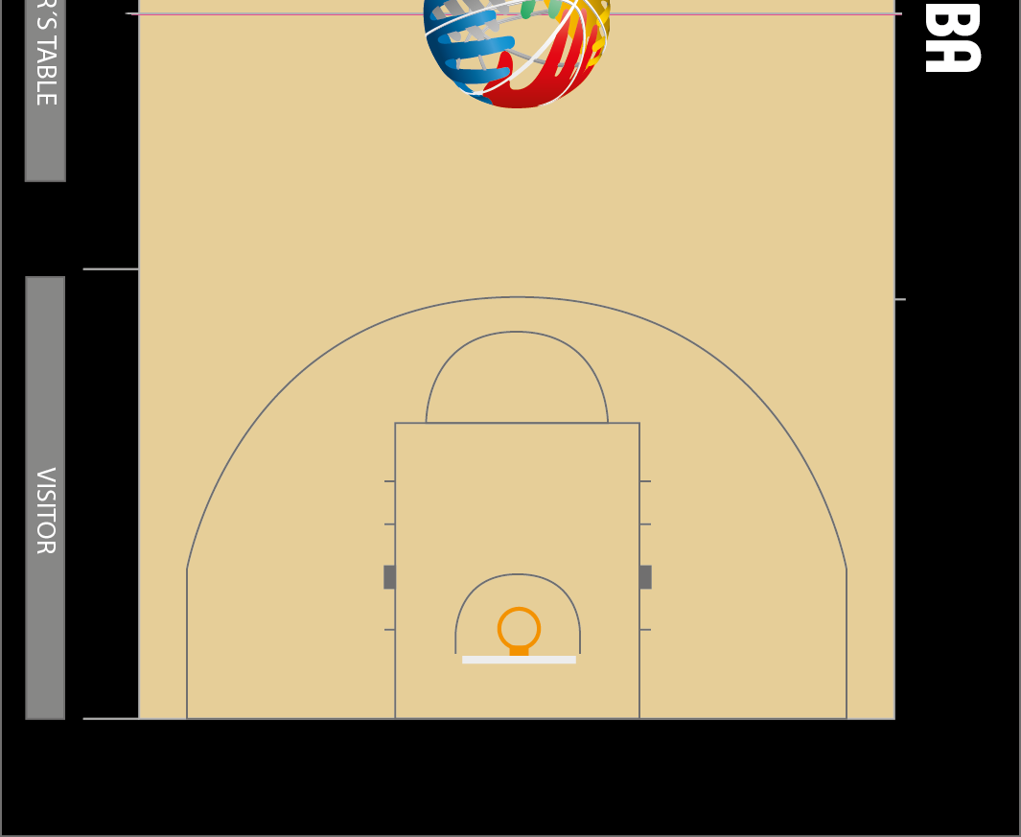
Strong & weak side / ball & opposite side
HSB / page 188
Opposite side
Ball side
Strong side
Weak side
Notes:
FIBA
ME-11_L_time_distance_
stationary_referee defence
ME-15_Afrobasket_L+C_ distance and until end of action
ME-21_new L too slow in transition

Slide 10
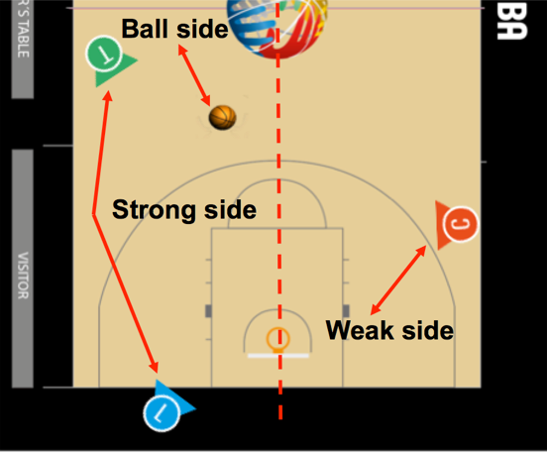
Strong & weak side / ball & opposite side
HSB / page 188
Two referees on the ball-side as much as possible.
You will have secondary coverage when necessary.
Best angle for L&T to referee the play
Primary action area (bus station) will be on ball-side
Action area
Notes:
FIBA
ME-11_L_time_distance_
stationary_referee defence
ME-15_Afrobasket_L+C_ distance and until end of action
ME-21_new L too slow in transition

Slide 11
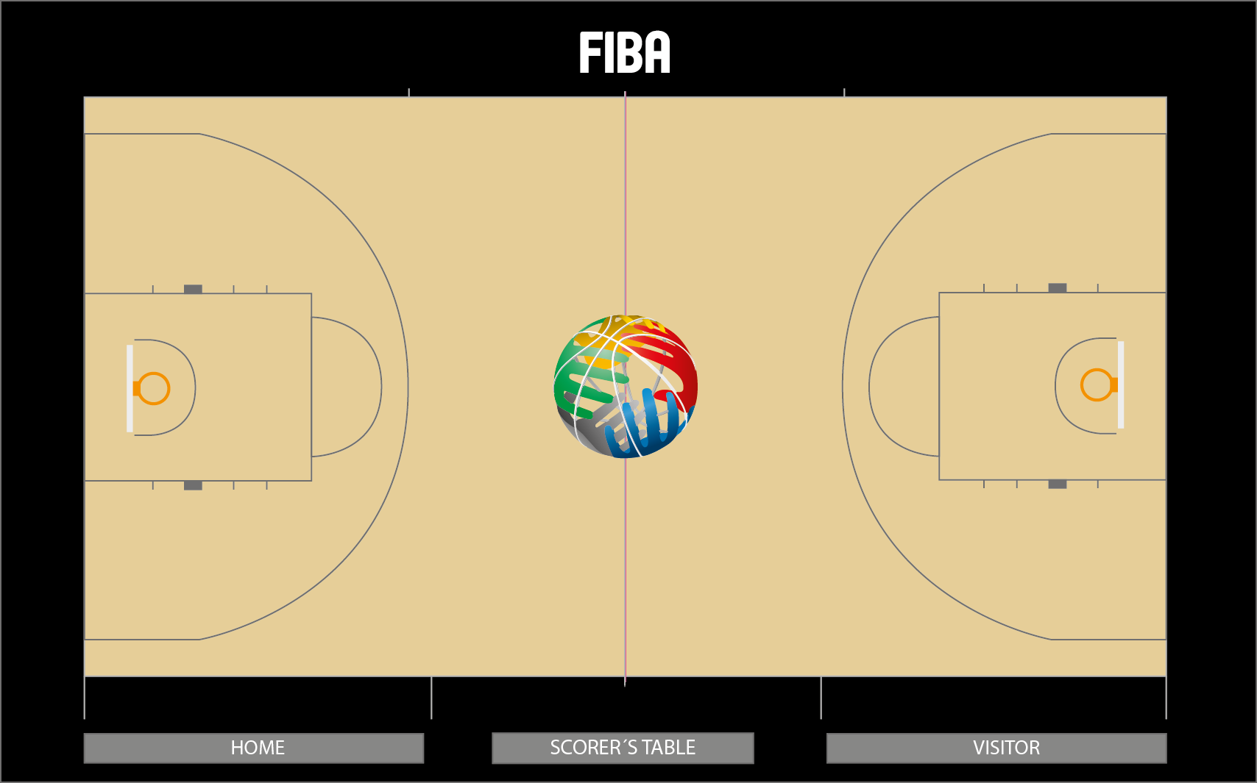
Court positioning / pre-game & halftime
HSB / page189

Slide 12
Court positioning / pre-game & halftime
HSB / page 189
Optional: two referees are warming-up and one is observing teams
See: “Improve Your Game Warm-Up”

Slide 13
Court positions / time-outs 1
HSB / page 189
The three standard time-out positions – always in the opposite side.
Leave the ball where the game will be resumed.

Slide 14
Court positions / time-outs 2
HSB / page 189
20 seconds before end of the time-outs – two referees move close to team bench areas in order to be ready to activate teams returning to the court at 50 seconds warning signal.

Slide 15
Court positioning / Opening Jumpball
HSB / page 190

Slide 16
Jumpball – play goes to the right
HSB / page 191

Slide 17
Jumpball – play goes to the left
HSB / page 191

Slide 18
Start of the pEriod
HSB / page 191
The Referee (Crew Chief) will always be the administering official for the throw-in opposite-side to start the periods. U1 and U2 will place themselves either in L or C position.

